Slide 1

Geometry
Unit 9, Lesson 11 Determining Surface Area Given Dimension Changes Volume 2, pg. 112

Slide 2


Benchmark
MA.912.GR.4.3
Extend previous understanding of scale drawings and scale factors to determine how dilations affect the area of two-dimensional figures and the surface area or volume of three-dimensional figures.
volume 2, pg. 112

Slide 3
Integrated Mathematical Thinking and Reasoning Standards
MA.K12.MTR.1.1 Actively participate in effortful learning both individually and collectively.
MA.K12.MTR.2.1 Demonstrate understanding by representing problems in multiple ways.
MA.K12.MTR.3.1 Complete tasks with mathematical fluency.
MA.K12.MTR.4.1 Engage in discussions that reflect on the mathematical thinking of self and others.
MA.K12.MTR.5.1 Use patterns and structure to help understand and connect mathematical concepts.
MA.K12.MTR.6.1 Assess the reasonableness of solutions.
MA.K12.MTR.7.1 Apply mathematics to real-world contexts.
volume 2, pg. 112

Slide 4

Learning Targets
I can find the area of a figure when one or both dimensions are changed.
I can find the surface area of a three-dimensional figure when one or both dimensions are changed.
volume 2, pg. 112

Slide 5

Warm-Up
volume 2, pg. 112

Slide 6
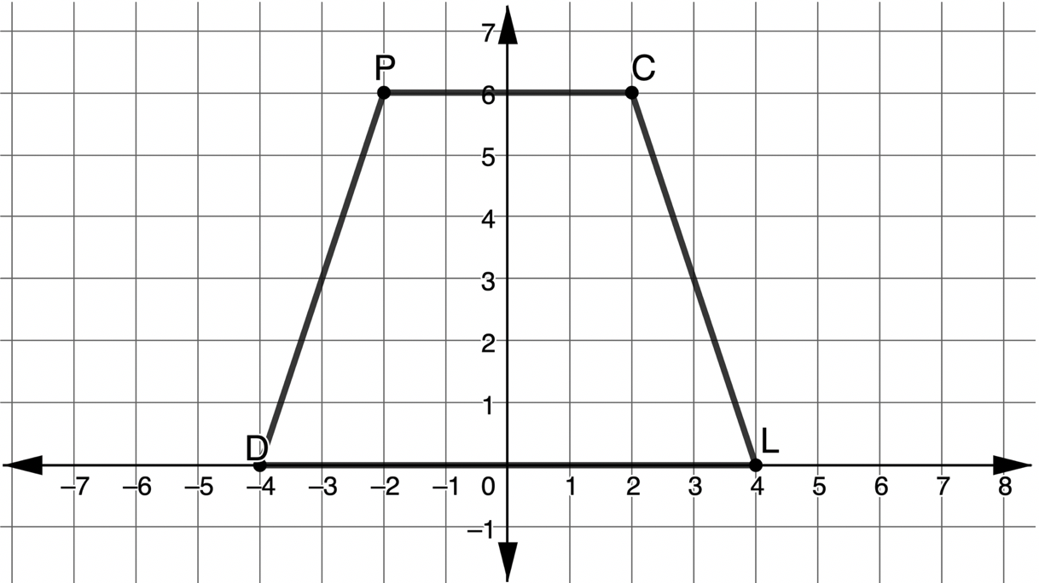

9.11.1 Warm-Up: Bell Work
Trapezoid $DPCL$ is shown in the coordinate plane.
Find the area of $DPCL$.
volume 2, pg. 112

Slide 7
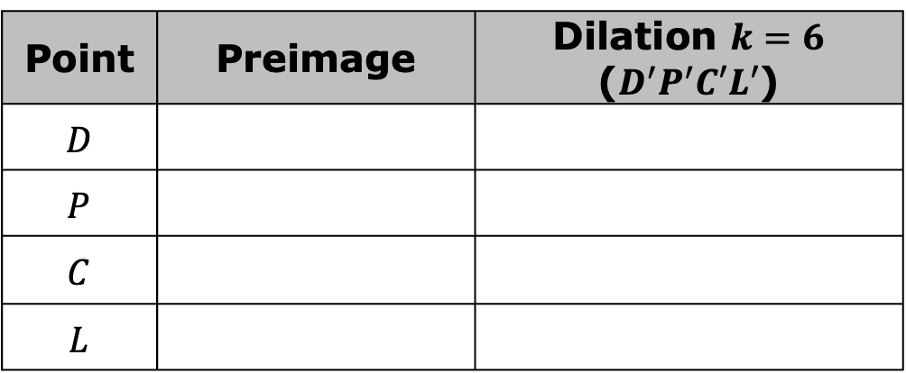
Find the coordinates of the image of $MTRD$ given the scale factor in the table. Use the preimage coordinates to find the coordinates of the image. The dilation is centered at $\left(0,0\right)$.
Point | Preimage | Dilation $k=6$ ($D^{′}P^{′}C′L′$)
$$D$$
$$P$$
$$C$$
$$L$$
volume 2, pg. 112

Slide 8

Exploration
volume 2, pg. 113

Slide 9

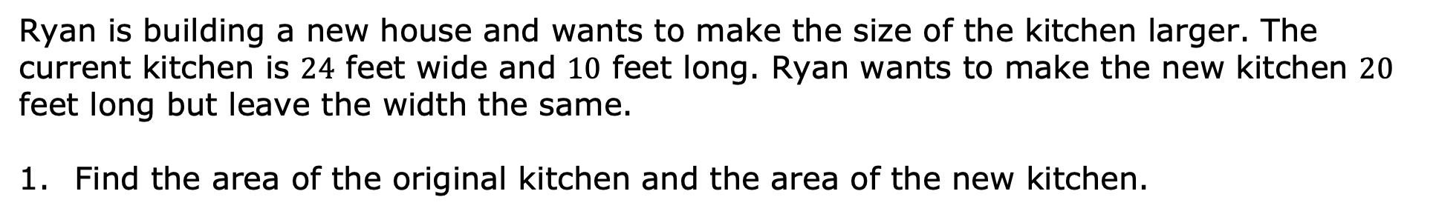
9.11.2 Exploration: Ryan’s Renovations
Ryan is building a new house and wants to make the size of the kitchen larger. The current kitchen is $24$ feet wide and $10$ feet long. Ryan wants to make the new kitchen $20$ feet long but leave the width the same.
Find the area of the original kitchen and the area of the new kitchen.
Area of the Original Kitchen | Area of the New Kitchen
volume 2, pg. 113

Slide 10
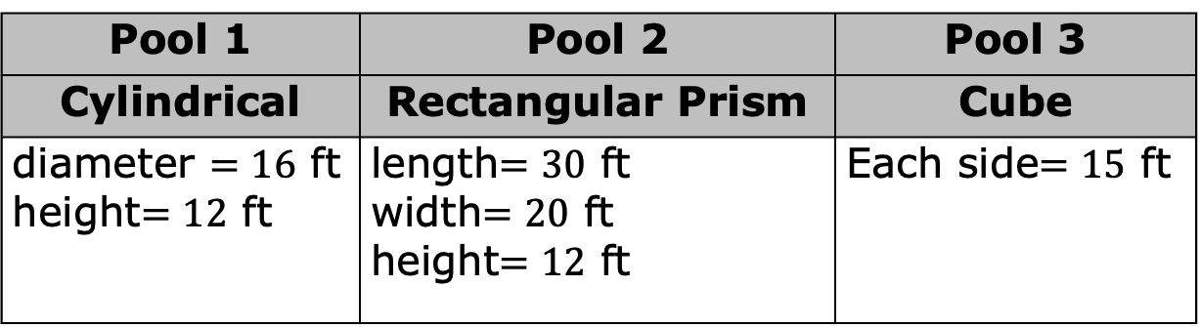
How do the areas compare?
Ryan also wants to install a pool for his new house. The construction company gives Ryan three shape options for the new pool. Each pool’s dimensions are given in feet (ft).
Pool 1 | Pool 2 | Pool 3
Cylindrical | Rectangular Prism | Cube
diameter $=16$ ft height$=12$ ft | length$=30$ ft width$=20$ ft height$=12$ ft | Each side$=15$ ft
volume 2, pg. 113

Slide 11
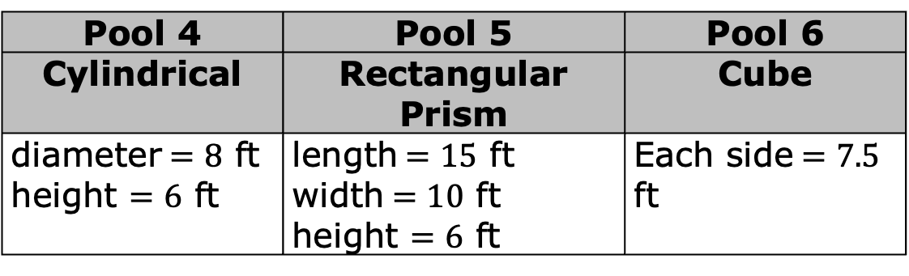
Find the surface area of each of the shapes for the three pool options. Round to the nearest thousandth.
The construction company is giving Ryan more options for building a swimming pool. The three options are listed in the table.
Pool 1 | Pool 2 | Pool 3
Pool 4 | Pool 5 | Pool 6
Cylindrical | Rectangular Prism | Cube
diameter$=8$ ft height $=6$ ft | length$=15$ ft width$=10$ ft height $=6$ ft | Each side$=7.5$ ft
volume 2, pg. 113

Slide 12
Describe how the dimensions of pair of pools are related.
Pair | Description
Pool 1 and Pool 4
Pool 2 and Pool 5
Pool 3 and Pool 6
volume 2, pg. 113

Slide 13
Find the surface area of each of the shapes for the three new options for a pool. Round to the nearest thousandth.
Pool 4 | Pool 5 | Pool 6
volume 2, pg. 114

Slide 14
Record the surface area of all pool shapes in the table below.
Pool | Surface Area
1
2
3
4
5
6
volume 2, pg. 114

Slide 15
The cost of building the swimming pool is dependent upon the amount of material. Since the top of each of the shapes would be water, determine the surface area of each pool that could be used to determine the cost.
Complete the table.
Pool | Surface Area for Material
1
2
3
4
5
6
volume 2, pg. 114

Slide 16
If Ryan wants the least expensive pool, which one should he purchase?
Which pool would you purchase? State your reasoning.
volume 2, pg. 114

Slide 17

Guided Practice
volume 2, pg. 115

Slide 18

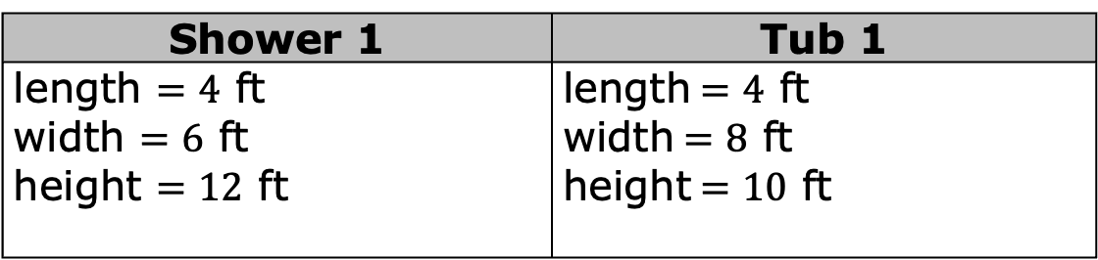
9.11.3 Guided Practice: Ryan’s House
Ryan is building a bathroom and needs to install either a bathtub or a shower.
The options for each bathroom size are given.
In order to determine the amount of drywall, Ryan needs to find the surface area of each of the room options.
Shower 1 | Tub 1
length $=4$ ft width $=6$ ft height $=12$ ft | length$=4$ ft width$=8$ ft height$=10$ ft
Shower 1 | Tub 1
volume 2, pg. 115

Slide 19
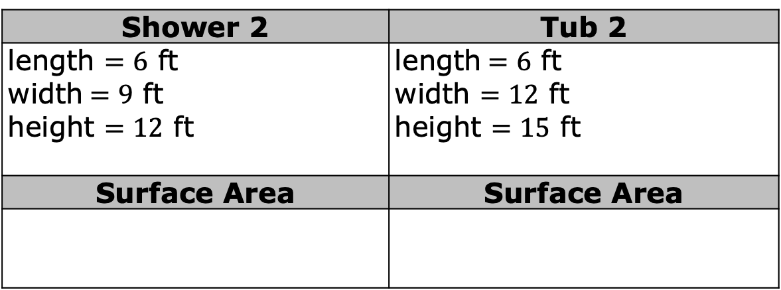

Ryan determines that the dimensions of the shower and tub are not up to code. The updated dimensions are shown. Use the new dimensions to determine the surface area of each room.
Two of Shower 2’s dimensions were changed by a factor of $1.5$, whereas all of Tub 2’s dimensions were changed by a factor of $1.5$. Discuss with your partner on how to use the factor $1.5$ and the number of changes in dimensions to find the new surface area from the original surface area.
Shower 2 | Tub 2
length $=6$ ft width$=9$ ft height $=12$ ft | length$=6$ ft width $=12$ ft height $=15$ ft
Surface Area | Surface Area
volume 2, pg. 115

Slide 20
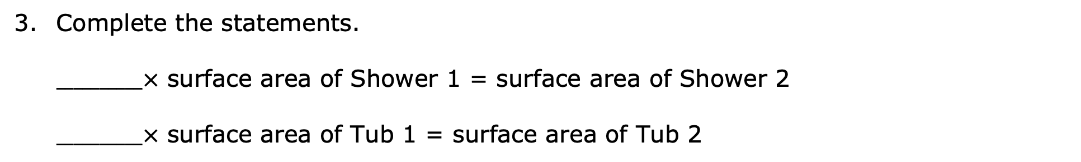
Complete the statements.
$__________×$ surface area of Shower 1 = surface area of Shower 2
$__________×$ surface area of Tub 1 = surface area of Tub 2
volume 2, pg. 115

Slide 21

Your Turn
volume 2, pg. 116

Slide 22
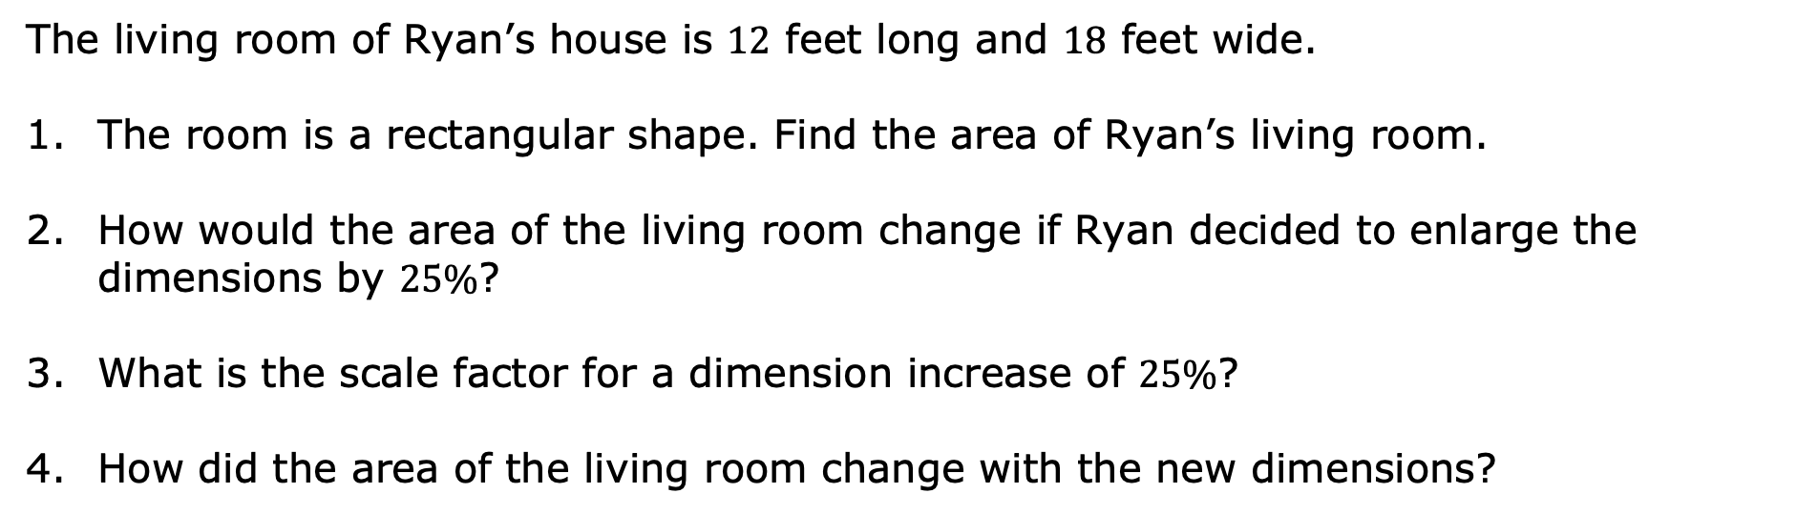
9.11.4 Your Turn!
The living room of Ryan’s house is $12$ feet long and $18$ feet wide.
The room is a rectangular shape. Find the area of Ryan’s living room.
How would the area of the living room change if Ryan decided to enlarge the dimensions by $25\%$?
What is the scale factor for a dimension increase of $25\%$?
How did the area of the living room change with the new dimensions?
volume 2, pg. 116

Slide 23

Wrap-Up
volume 2, pg. 116

Slide 24
9.11.5 Wrap-Up: Cool Down
Write a summary of what you learned in this lesson.
volume 2, pg. 116

